Slide 1
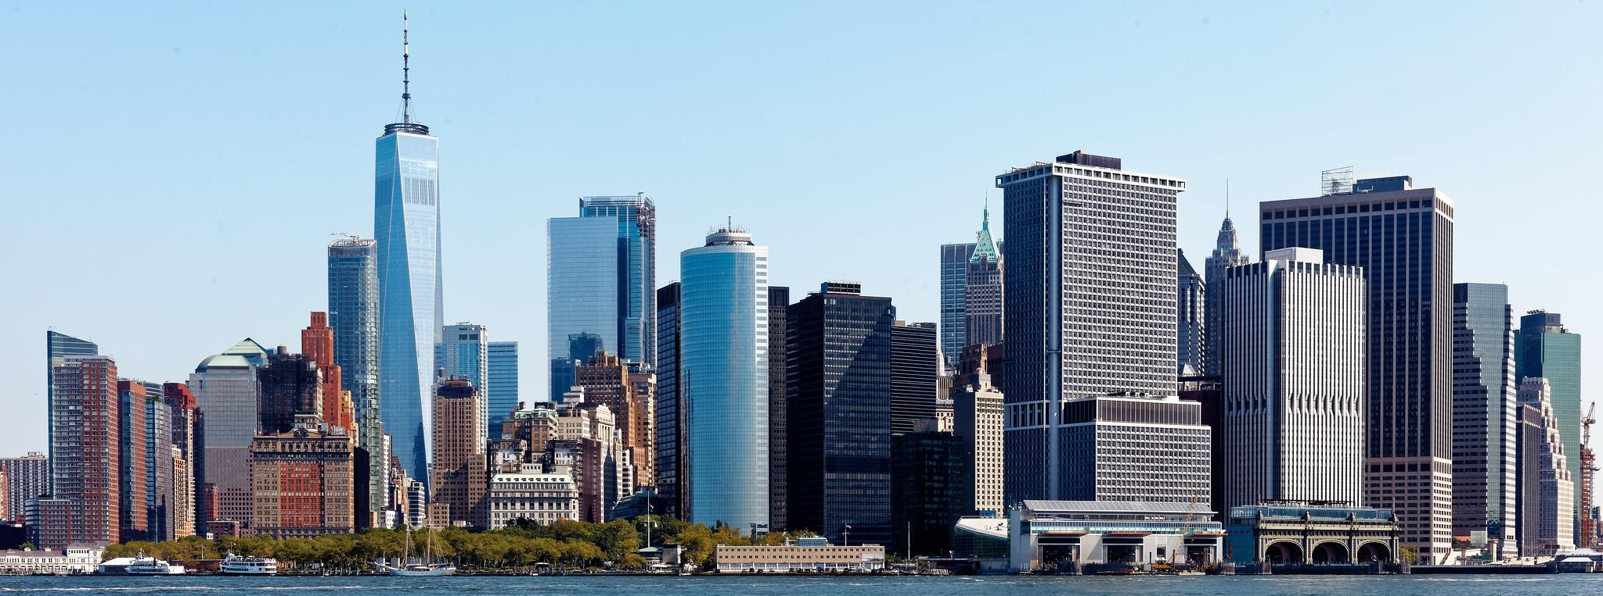
New York City Air Quality Analysis
February 20, 2025
Team 2 Members:
Abid, Kaouther Khant, Myatminn Carlton, Mikaela Lane, Chris
Dorsainvil, Erika Legg, Lorelei Fetter, William Lopez, Grecia
Park, Sae Hodzic, Melisa Robinson, Charisse Kafle, Rumani
Notes:
lorelei

Slide 2

Introduction
This presentation explores air pollution trends in NYC using an interactive Heatmap, Time-Series line chart and a Pollution Bar Chart.
The research aims to identify trends over time, compare pollutants, and determine the most polluted areas.
The goal is to visualize trends and provide insights into the impact of air quality.
DATA Source:
• NYC Open Data - Air Quality
Notes:
lorelei

Slide 3
Data Processing, Storage & Cleansing:
The data was retrieved and filtered by borough and pollutant type to include the years of 2009-2022 and the pollutants PM 2.5 and NO2. The csv file was imported to PostgresSQL to be stored. We created a json file that was used to create the line chart, heat map, and bar chart.
The Data Cleaning Tasks:
• Remove missing or corrupted data.
• Standardize date formats and pollutant measurements.
• Normalize borough names and locations.
Notes:
will

Slide 4
Research Questions:
How do different pollutants compare in terms of concentration?
What are the trends in air pollution across NYC boroughs over time?
Which areas in NYC experience the highest levels of pollution?
Notes:
Will

Slide 5
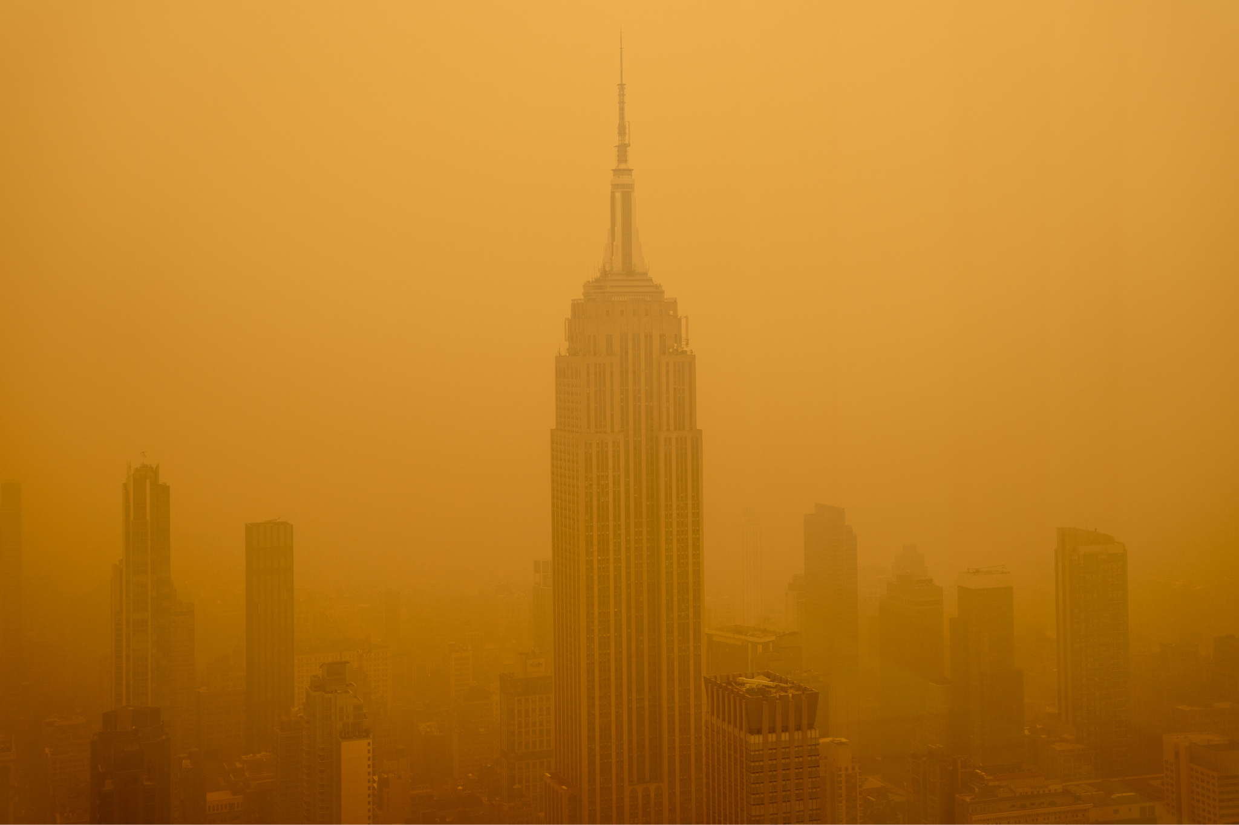
Understanding Air Pollutants: NO₂ & PM 2.5
What is NO₂?
Nitrogen Dioxide (NO₂) is a reddish-brown gas it belongs to a group of highly reactive gases known as nitrogen oxides (NOₓ).
Nitrogen dioxide is a mostly urban air pollutant that comes largely from traffic, industrial processes and power plants.
What is PM 2.5?
PM 2.5 refers to fine particulate matter that is 2.5 micrometers or smaller in diameter (about 1/30th the width of a human hair!).
These microscopic particles can stay suspended in the air for long periods and penetrate deep into the lungs and bloodstream.
PM 2.5 comes from a wide range of sources, including traffic, industrial plants, agriculture, wildfire smoke, and dust.
Notes:
Melisa

Slide 6
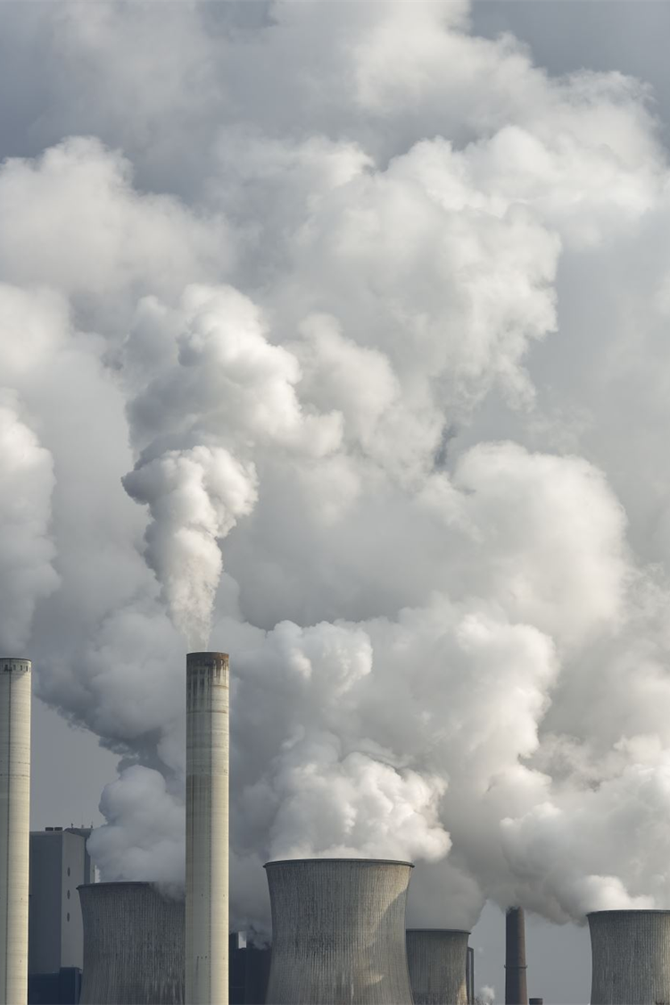
Comparison of Different Pollutants
Fine Particles (PM 2.5) is more widespread across NYC, impacting all boroughs.
PM 2.5 affects respiratory and cardiovascular health.
Nitrogen Dioxide (NO2) concentrations are highest in high-traffic areas like Midtown Manhattan.
NO2 is linked to lung irritation and asthma, especially in urban zones.
Notes:
Mikaela

Slide 7
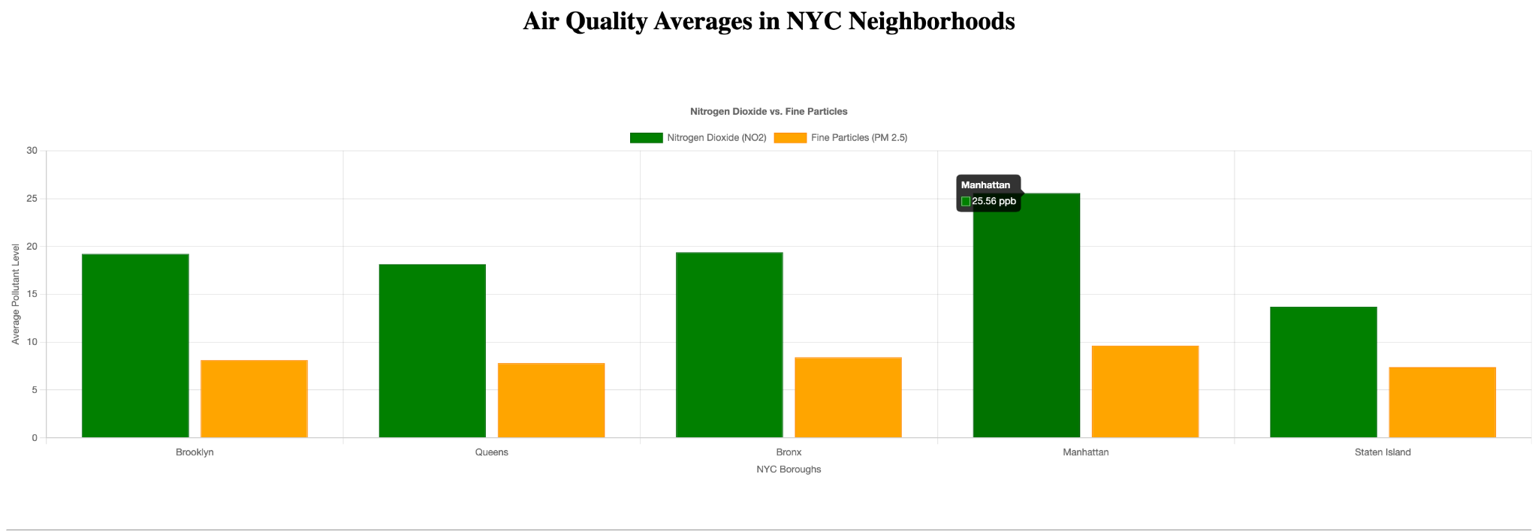
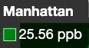
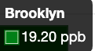
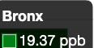
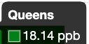
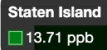
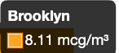
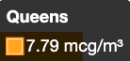



Borough Pollution Bar Chart:
JavaScript Library - Chart.js
Method - Calculated cumulative average pollutant levels of Nitrogen Dioxide and Fine Particles for all boroughs in New York City.
Highest NO2 Concentration - Manhattan (25.56 ppb)
Lowest NO2 Concentration - Staten Island (13.71 ppb)
Highest PM2.5 Concentration - Manhattan (9.64 mcg/m3)
Lowest PM2.5 Concentration - Staten Island (7.38 mcg/m3)
Manhattan: High traffic congestion, industrial activity, and densely packed buildings.
Staten Island: Lower population density, fewer traffic sources, more open spaces, less constructio..
Notes:
rumani

Slide 8
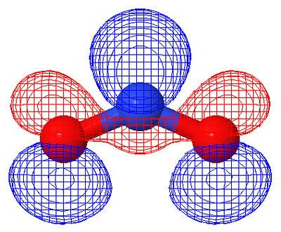
Time-Series Line Chart:
Tracks changes over years helps us see the impact of policies, urbanization, and climate efforts.
Our time series analysis shows how NYC boroughs have improved over time
.
Notes:
charisse

Slide 9
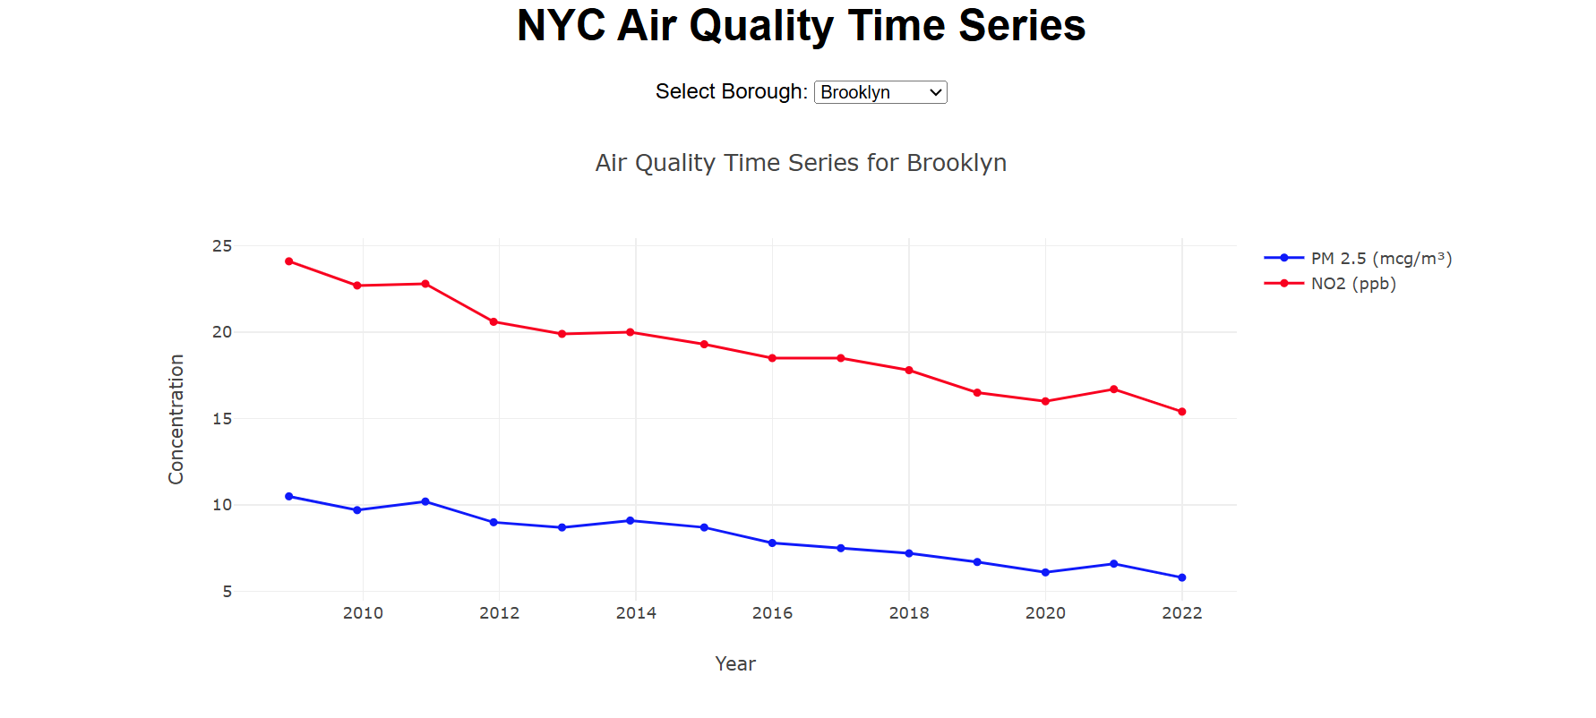
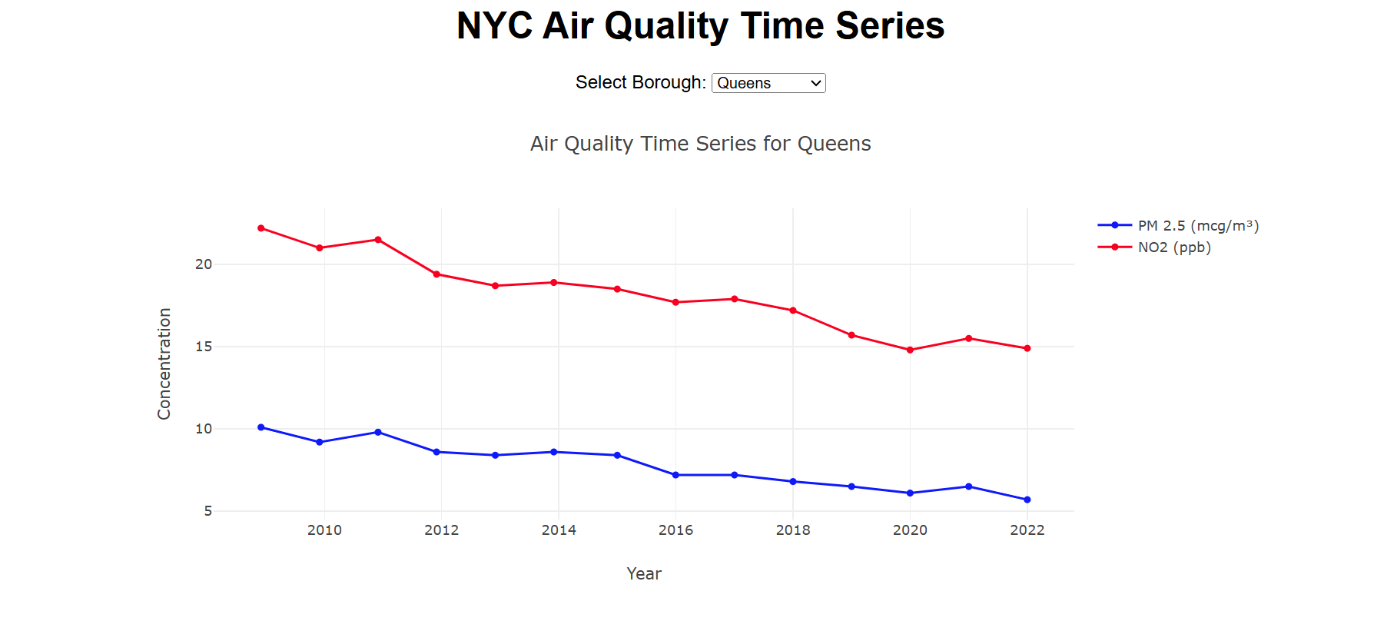
Time-Series Line Chart:
Brooklyn
Improvement in air quality.
NO₂ 22.8 → 15.4 ppb, PM2.5 10.5 → 6.6 mcg/m³.
Queens
Steady Decline in pollutants.
NO₂ 22.2 → 14.9 ppb, PM2.5 10.1 → 5.7 mcg/m³.
Notes:
charisse

Slide 10
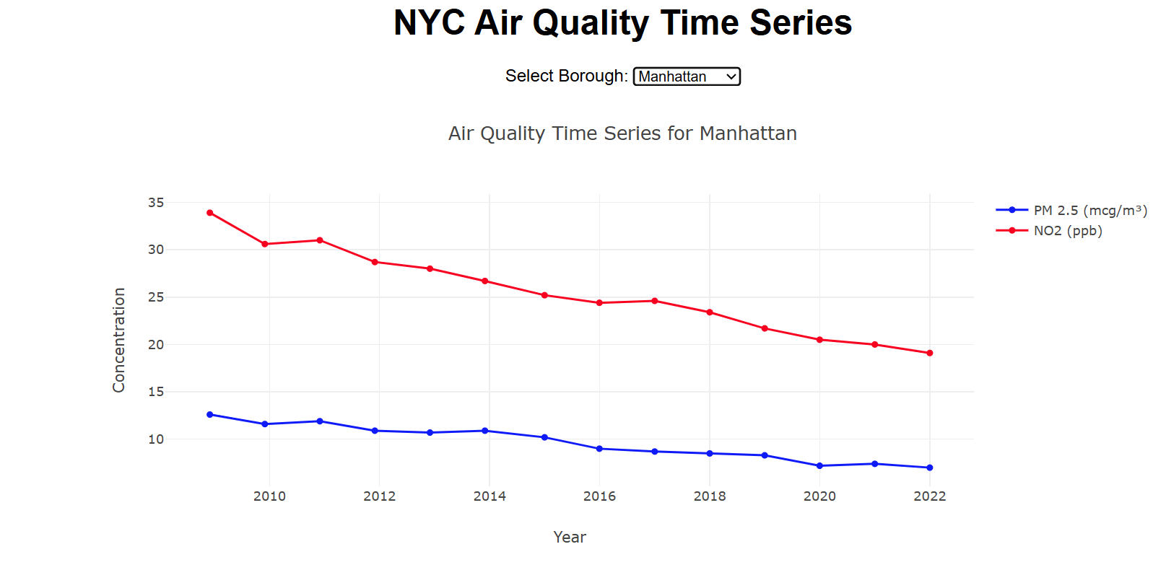
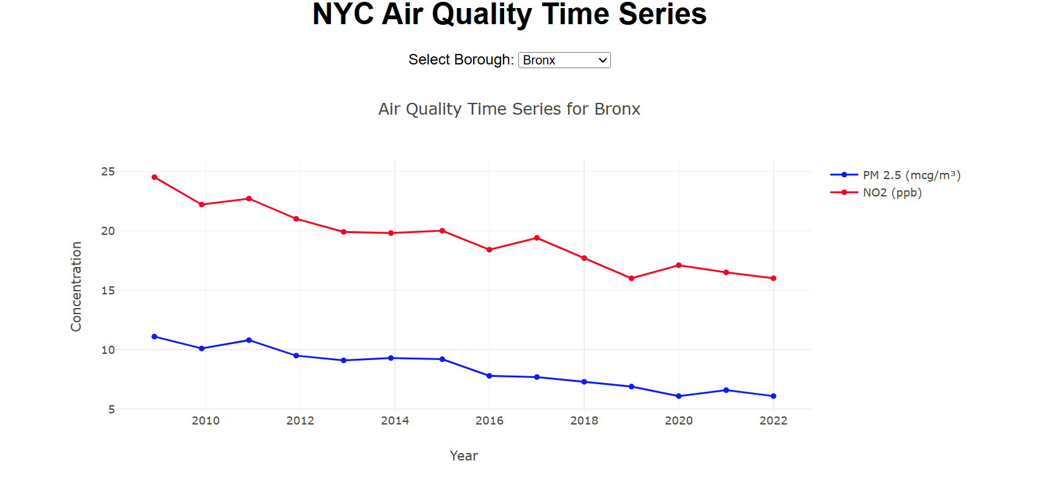
Time-Series Line Chart:
Bronx
Biggest improvement. NO₂ 24.5 → 16 ppb, PM2.5 11.1 → 6.1 mcg/m³
Manhattan
Still the most polluted. NO₂ 33.9 → 19.1 ppb, PM2.5 12.6 → 7 mcg/m³
Traffic could be a challenge.
Notes:
Manhattan
PM 2.5 reduced by 42.3% from 2008 to 2022
NO2 reduced by 44.1%, with notable improvements since 2015
Bronx
PM 2.5 levels decreasing steadily, but slower than Manhattan
NO2 levels show fluctuations, indicating inconsistent improvement

Slide 11
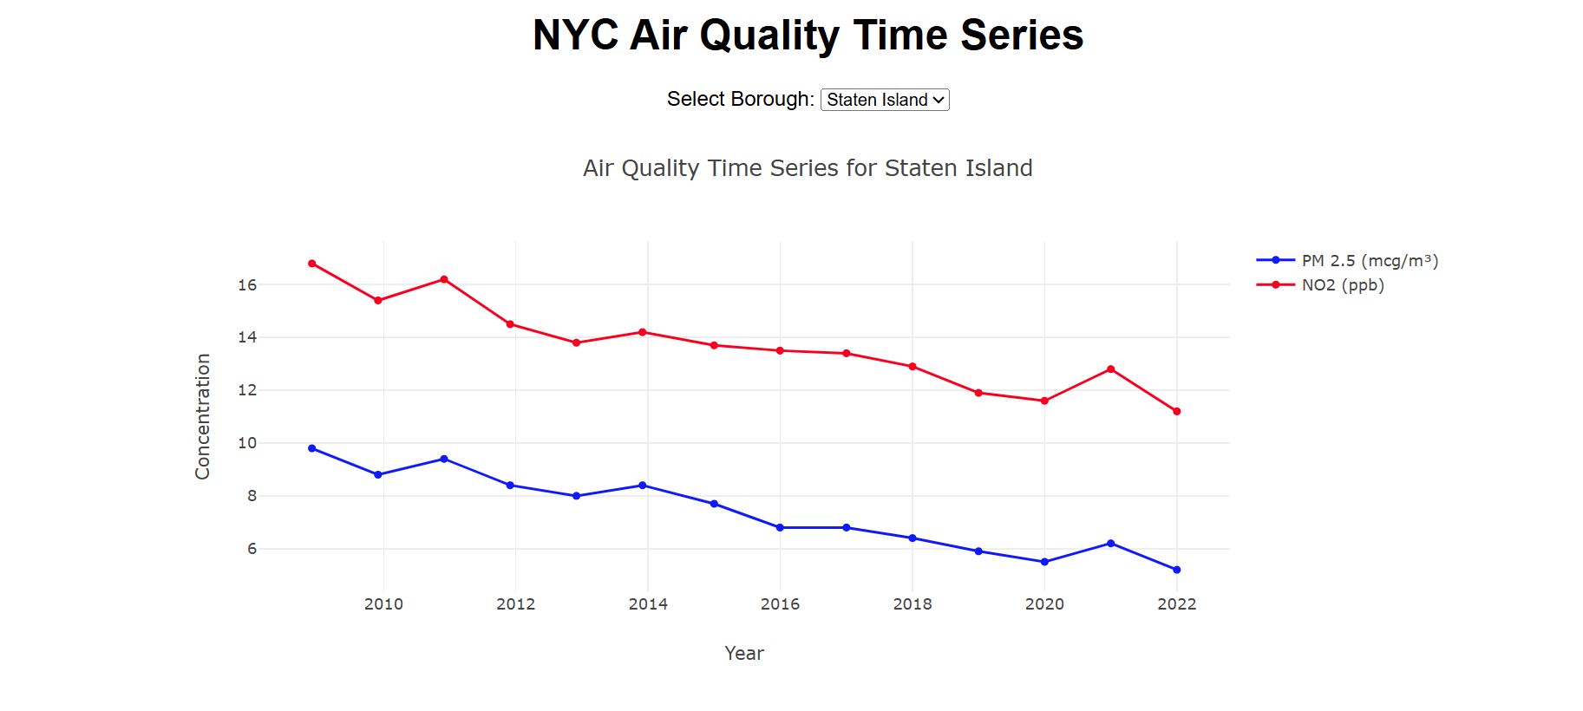
Time-Series Line Chart:
Staten Island
Best air quality. NO₂ 16.8 → 11.2 ppb, PM2.5 9.8 → 5.2 mcg/m³.
Low traffic & open space may have helped
Notes:
Staten Island
Consistent decrease in both PM 2.5 and NO2
Lowest pollution levels among these boroughs

Slide 12
Time-Series Line Chart Conclusion
Best Air Quality: Staten Island
NO₂: 16.8 ppb (2009) → 11.2 ppb (2022)
PM2.5: 9.8 mcg/m³ (2009) → 5.2 mcg/m³ (2022)
Better air quality from the start, but improvements weren’t as drastic.
Worst Air Quality: Manhattan
NO₂: 33.9 ppb (2009) → 19.1 ppb (2022)
PM2.5: 12.6 mcg/m³ (2009) → 7 mcg/m³ (2022)
Improved a lot but still has the highest pollution - does improvement mean good air quality?
All boroughs improved significantly, but urban density slows progress.
Notes:
GRECIA
AS A CONCLUSION FOR THIS
Between 2009 and 2022, NYC’s air quality improved across all boroughs but not equally.
Staten Island had the best air from the start, with NITROGEN DIOXIDE dropping from 16.8 to 11.2 ppb and PM2.5 from 9.8 to 5.2 MICROGRAMS PER CUBIC METER)
Less traffic, more open space—less of a fight.
Manhattan, on the other hand, started with the worst air—NITROGEN DIOXIDE at 33.9 ppb, PM2.5 at 12.6 MICROGRAMS PER CUBIC METER. By 2022, those numbers fell to 19.1 and 7,
a big drop but still the highest in the city.
Leading us to assume that improvement doesnt necessarily equal to good air quality.
Our time-series chart tracks these shifts dynamically between boroughs with a drop down menu. The takeaway? Progress happens, but as shown, urban density slows it down

Slide 13
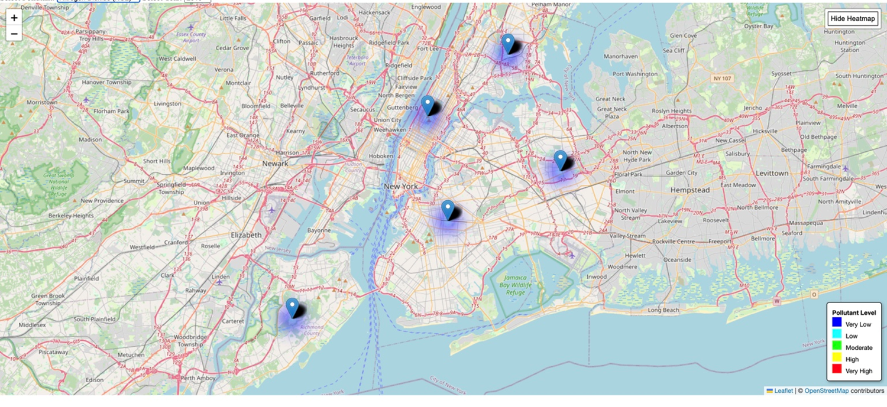
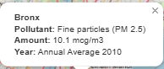
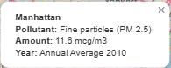
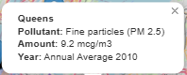
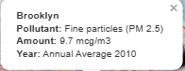
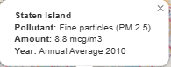
Geospatial Heatmap
The heatmap shows fluctuating pollution trends over the years.
Manhattan and the Bronx consistently show higher pollution levels.
Improvements are visible in some areas due to environmental regulations.
Seasonal variations may influence pollution levels.
Notes:
chris/erika

Slide 14
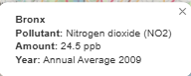
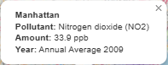
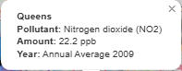
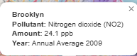
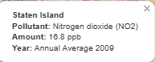
Geospatial Heatmap
NO₂ levels vary over time, indicating seasonal or event-driven changes.
Manhattan’s high NO₂ concentrations consistently records the highest NO₂ levels, often exceeding 30 ppb in certain years.
Brooklyn and the Bronx show elevated NO₂ levels, while Queens and Staten Island maintain the lowest concentrations.
The heatmap effectively highlights pollution disparities across boroughs, making it easier to analyze trends over time.
Notes:
erika/chris

Slide 15
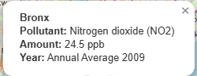
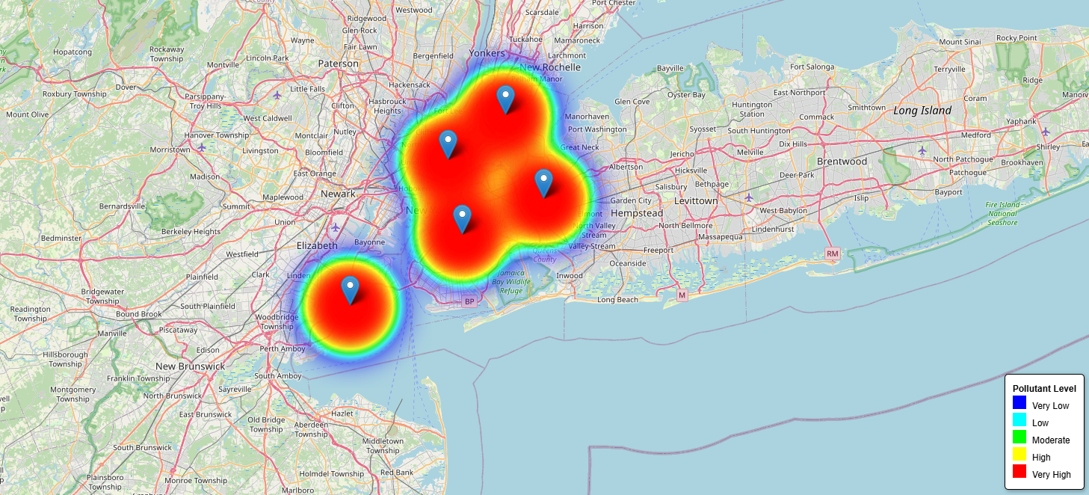
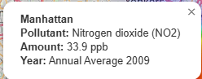
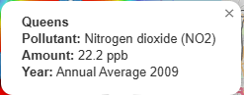
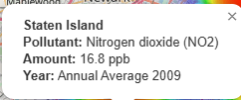
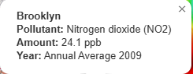
Geospatial Heatmap
**Can be seen more vividly if the radius and blur are adjusted within the script. For presentation purposes this slide was manually added.
Increasing radius, blur, and max zoom in the HeatMap.js file enhances color intensity, making pollution hotspots more distinguishable.
Notes:
erika/chris

Slide 16
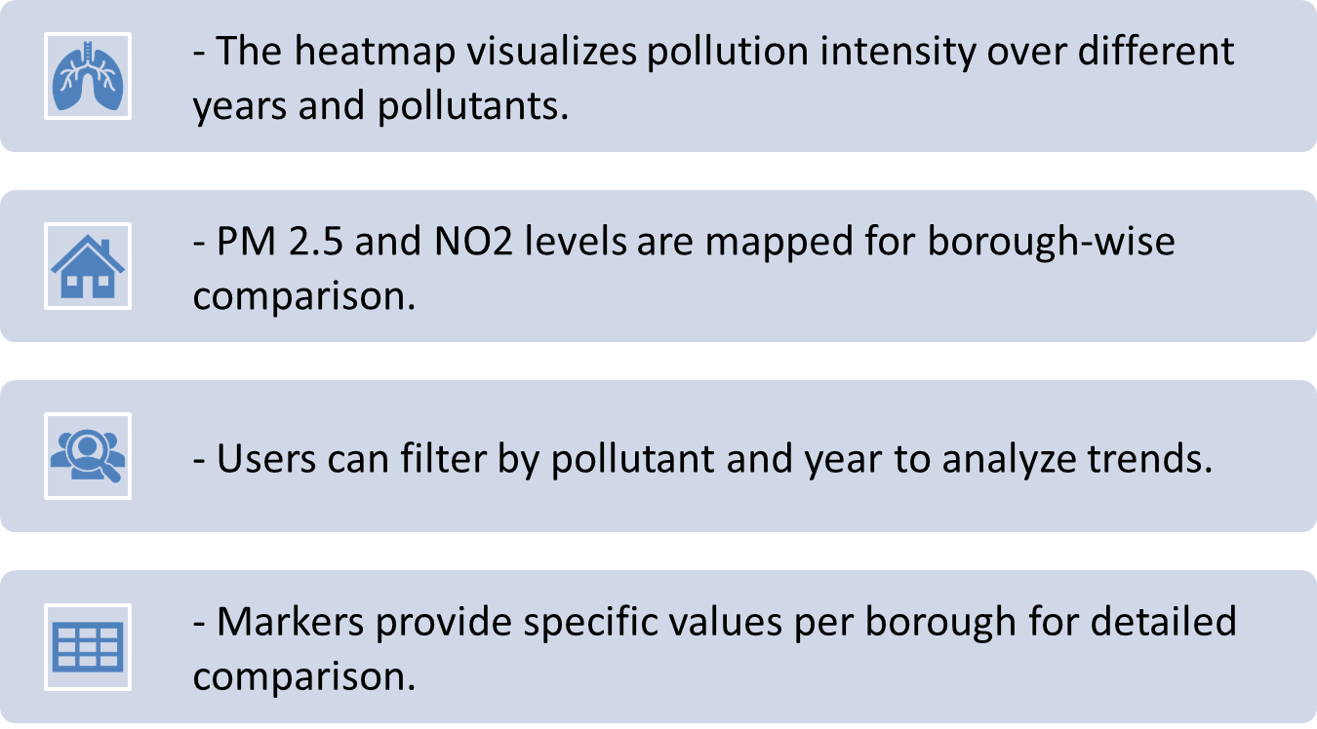
Geospatial Heatmap Data & Methodology:
Notes:
erika/chris

Slide 17

Recommendations
Continue monitoring and analyzing air quality data to track trends and identify areas for improvement.
Implement targeted policies to reduce NO2 levels in dense urban areas, focusing on strategies to decrease vehicle emissions and promote sustainable urban planning.
Enhance collaboration between government agencies, industries, and communities to address air quality issues collectively and sustainably.
Notes:
Kaouther - Recommendations

Slide 18

Conclusion
Air pollution levels in NYC vary across boroughs, with traffic and industrial activity being major contributors.
While policy interventions have led to improvements over time, certain areas—especially Manhattan and the Bronx—continue to experience high pollution levels.
Future efforts should focus on integrating real-time
monitoring, predictive modeling, and targeted policies to further enhance air quality and mitigate pollution challenges.
Notes:
Sae- Conclusion

